Slide 1
Interpreting Geologic History
Earth and Space Science
Earthcomm: Understanding Your Environment, pages 53-55

Slide 2
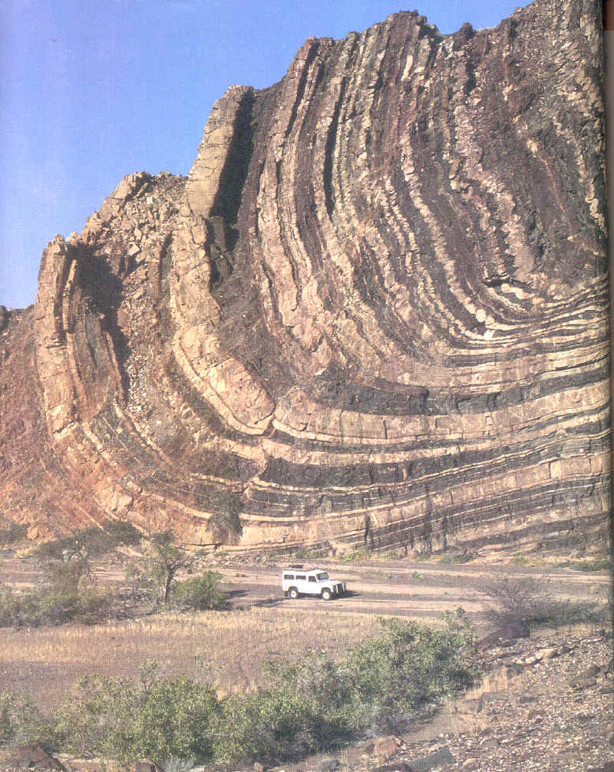
Geologic events such as deposition, erosion, folding, faulting, uplift, subsidence, igneous intrusion, volcanism, and metamorphism have changed the crust over time.

Slide 3
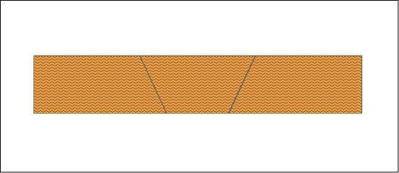
- Uplift – process where areas of the Earth’s
crust are slowly raised due to
expansion of the surrounding rock layers
rocks tend to expand when heated

Slide 4
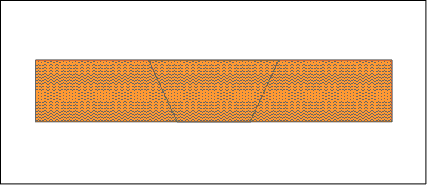
- Subsidence – process where areas of the
Earth’s crust slowly sink due to
the contraction of surrounding rocks
→ rocks tend to contract when cooled

Slide 5
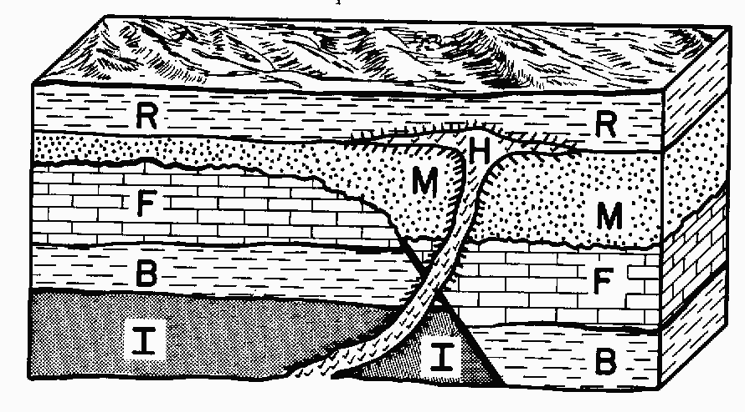
6 Basic Geologic Principles
Check out this website
YouTube clip
Helpful website

Slide 6
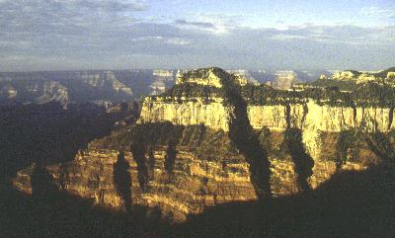
1. Principle of Superposition
Younger sedimentary and volcanic rocks are deposited on top of older rocks

Slide 7
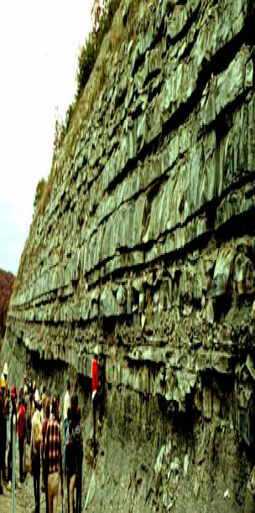
2. Principle of Original Horizontality
Sedimentary and volcanic rocks are laid down in approximately horizontal layers

Slide 8
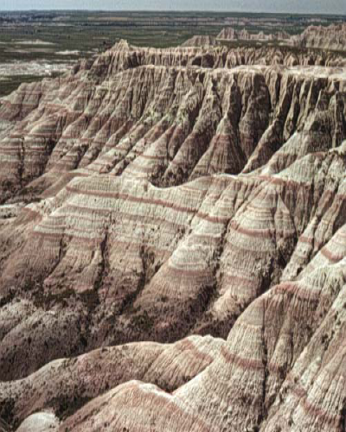
3. Principle of Lateral Continuity
Sedimentary and volcanic rocks are laid down in layers that are usually much wider (lateral extent) than they are thick

Slide 9
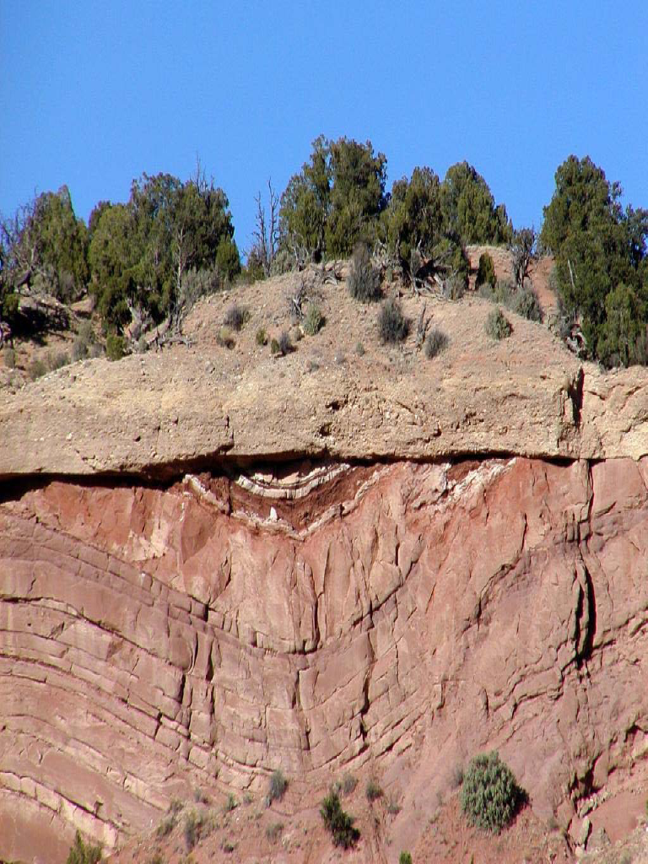
4. Principle Crosscutting Relationships
If one
rock or
geologic
structure
cuts
across
another
rock unit
or geologic feature the cutter is younger than
the rock which is being cut

Slide 10
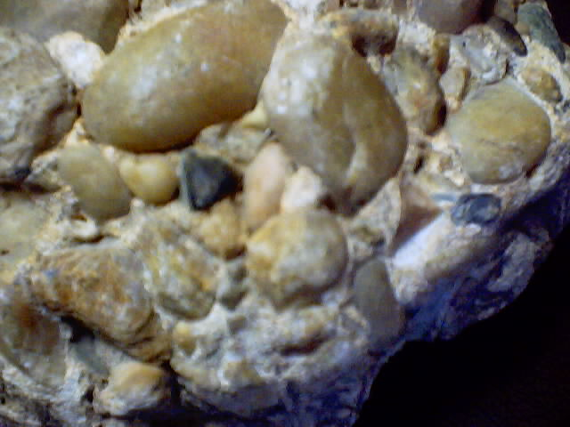
5. The law of included fragments
The fragments that make up a rock are older than the entire sample.

Slide 11
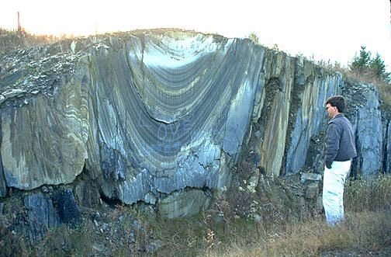
6. The Law of Folds or Tilts:
Tilts in rocks are younger than the rocks themselves.

Slide 12
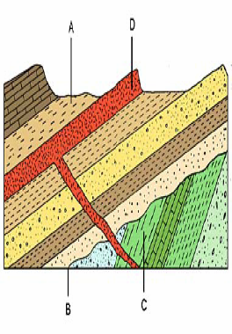
Geologic Cross-section #1

Slide 13
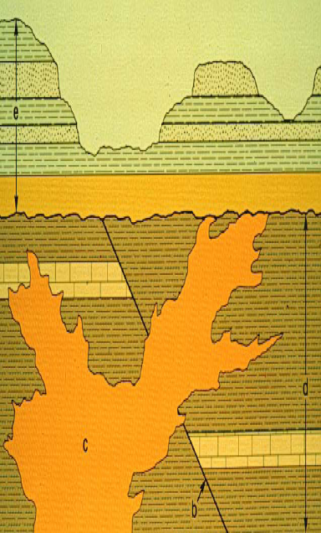
Geologic Cross-section #2

Slide 14
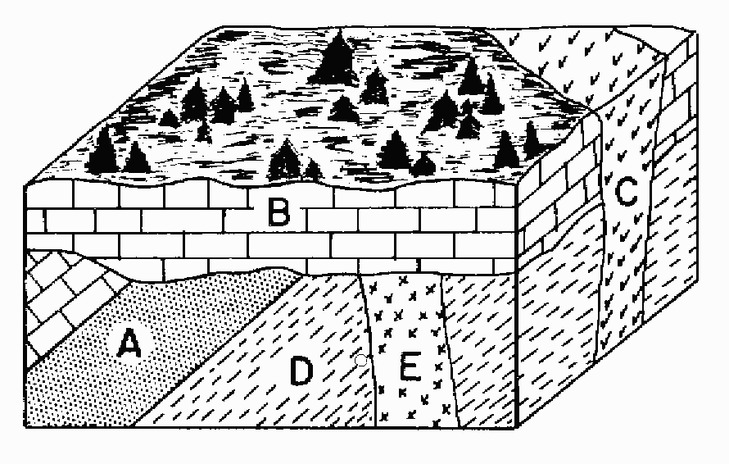
Geologic Cross-section #3

